Slide 1
7. Continuous Random Variables II

Slide 2
One random variable review
PMF f(x)
PDF f(x)
P(X ≤ a)
∑_{x ≤ a} f(x)
∫_{x ≤ a} f(x)dx
E[X]
∑_{x} x f(x)
∫_{x} x f(x)dx
E[X²]
∑_{x} x² f(x)
∫_{x} x² f(x)dx
Var[X]
E[(X – E[X])²] = E[X²] – E[X]²

Slide 3
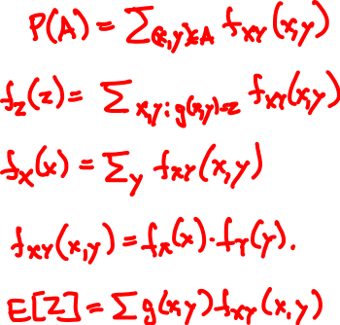
Discrete two variables review
joint PMF f_{XY}(x, y) = P(X = x, Y = y)
Probability of A
Derived RV Z = g(X, Y)
Marginals
Independence
Expectation

Slide 4
Continuous random variables
A pair of continuous random variables X, Y can be specified either by their joint c.d.f.
F_{XY}(x, y) = P(X ≤ x, Y ≤ y)
or by their joint p.d.f.
∂
∂
f_{XY}(x, y)
=
F_{XY}(x, y)
∂x
∂y
P(x < X ≤ x + ε, y < Y ≤ y + δ)
=
lim
ε, δ → 0
εδ

Slide 5

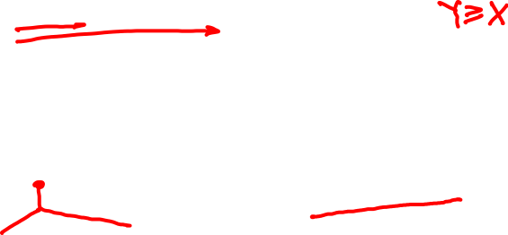
Rain drops at a rate of 1 drop/sec. Let X and Y be the arrival times of the first and second raindrop.
X
Y
F(x, y) = P(X ≤ x, Y ≤ y)
f(x, y)
=
∂
∂
F(x, y)
∂x
∂y

Slide 6
Continuous marginals
Joint CDF F_{XY}(x, y) = P(X ≤ x, Y ≤ y)
Marginal CDF:
F_{X}(x) = P(X ≤ x)
P(X ≤ x)
Exponential(1)

Slide 7
the continuous cheat sheet
X, Y continuous with joint p.d.f. f_{XY}(x, y)
Probability of A
P(A) = ∫∫_{A} f_{XY} (x, y) dxdy
Derived RV Z = g(X, Y)
f_{Z}(z) = ∫_{(x, y): g(x, y) = z} f_{XY}(x, y) dxdy
Marginals
∞
f_{X}(x) = ∫_{-∞} f_{XY}(x, y) dy
Independence
f_{XY}(x, y) = f_{X}(x) f_{Y}(y) for all x, y
Expectation
E[Z] = ∫∫ g(x, y) f_{XY}(x, y) dxdy

Slide 8
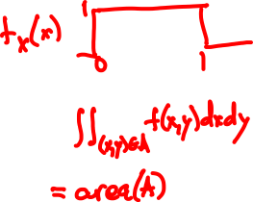
Independent uniform random variables
Let X, Y be independent Uniform(0, 1).
1
if 0 < x, y < 1
f_{XY}(x, y) = f_{X}(x) f_{Y}(y) =
0
if not
f_{XY}(x, y)
P(A) =

Slide 9
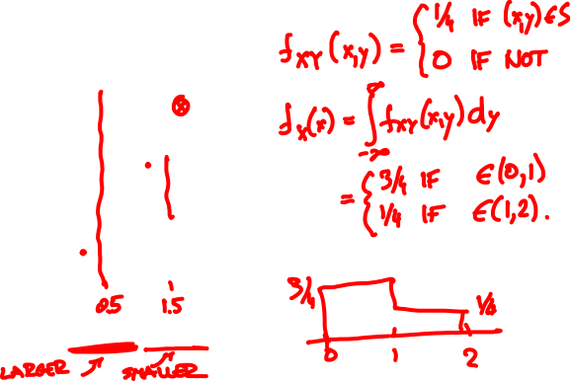
Joint PDF of X, Y is uniform over S.
What are the marginals?
y
3
2
S
1
0
x
0
1
2

Slide 10
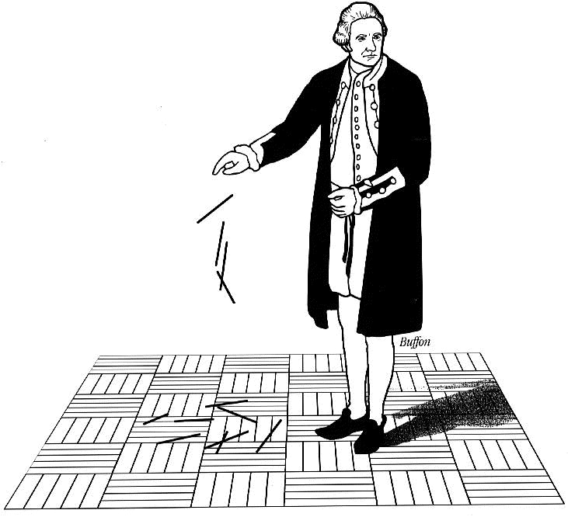
Buffon’s needle
A needle of length l is randomly dropped on a ruled sheet.
What is the probability that the needle hits one of the lines?

Slide 11
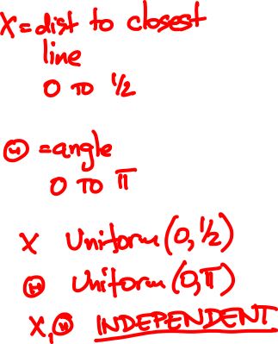
Probability model
X
Θ
1

Slide 12
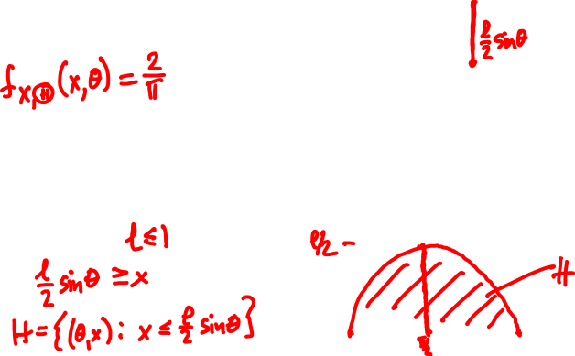
Buffon’s needle
l/2
PDF:
X
Θ
1
½
Event H :
x
0
0
θ
π

Slide 13
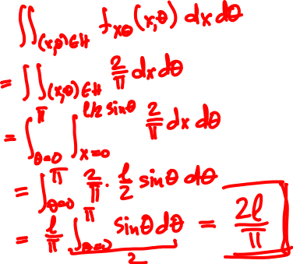
Buffon’s needle
Assume l ≤ 1 (short needle)
P(H) =

Slide 14
Conditioning
Y
discrete
continuous
X
P(X = x, Y = y)
discrete
P(X = x | Y = y) =
P(Y = y)
continuous

Slide 15
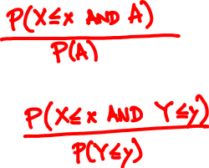
Conditioning
Y
discrete
continuous
X
discrete
P(X ≤ x | A) =
P(X ≤ x | Y ≤ y) =
continuous

Slide 16
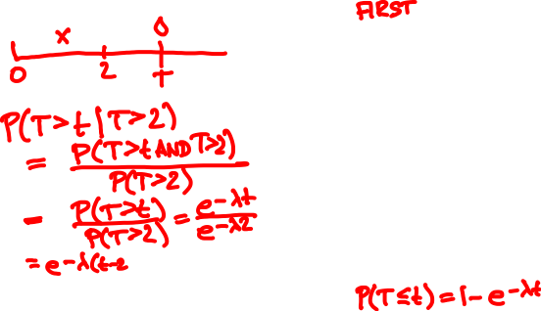
Rain drops at a rate λ = 1/sec.
You walk for 2 sec, no drop yet.
What is the arrival time of next drop?
Exponential(λ) CDF

Slide 17
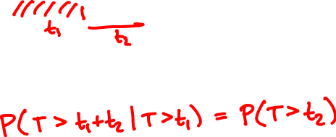
T
Memorylessness of Exponential(λ) RV:

Slide 18
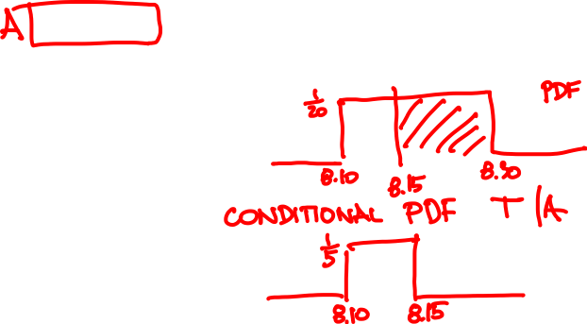

Alice arrives 8.10 - 8.30.
2430A
Given she caught the first bus, what is her arrival time?
8.15 AM
8.30 AM

Slide 19
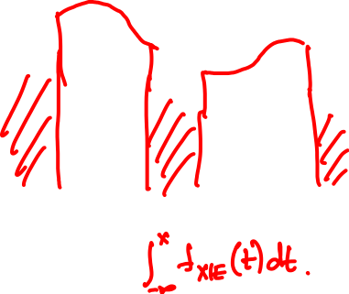
Conditioning a continuous RV on an event
f_{X}(x)
PDF:
f_{X | E} (x) =
when x ∈ E
P(E)
f_{X}(x)
x
E
CDF:
P(X ≤ x) =

Slide 20
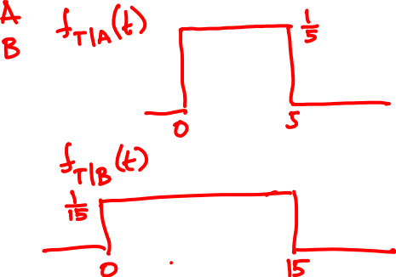
Arrival time is Uniform(10, 30)
2430A
Conditional waiting time PDF:
8.15 AM
8.30 AM

Slide 21
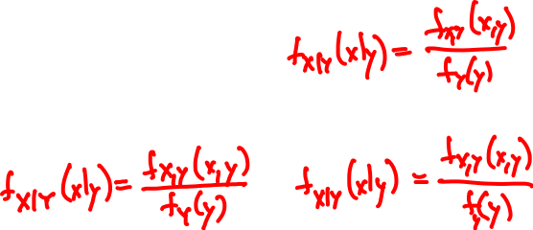
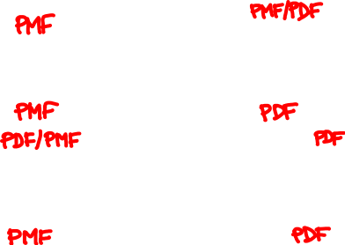
Conditioning
Y
discrete
continuous
X
f_{XY}(x, y)
f_{X|Y}(x | y) =
discrete
f_{Y}(y)
continuous

Slide 22
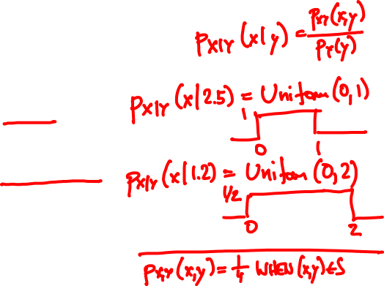
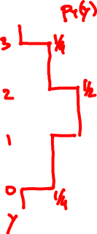


Joint PDF of X, Y is uniform over S.
What are the conditional PDFs?
y
3
2
S
1
0
x
0
1
2

Slide 23
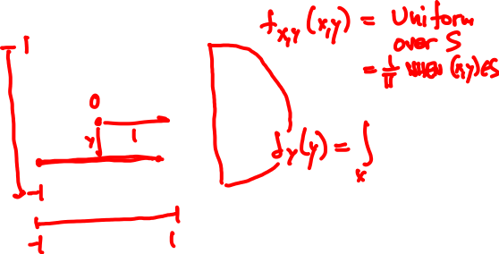
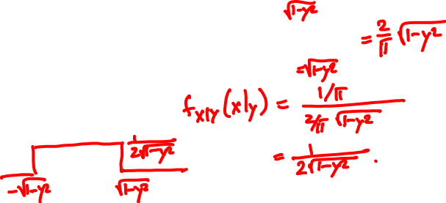


Joint PDF of X, Y is uniform over S.
What are the marginal and conditional PDFs?
S

Slide 24
Total probability theorem:
f_{X}(x) = ∑_{y} f_{X|Y}(x | y) f_{Y}(y)
Y discrete
f_{X}(x) = ∫ f_{X|Y}(x | y) f_{Y}(y) dy
Y continuous
Total expectation theorem:
E[X] = ∑_{y} E[X | Y = y] f_{Y}(y)
Y discrete
E[X] = ∫ E[X | Y = y] f_{Y}(y) dy
Y continuous

Slide 25
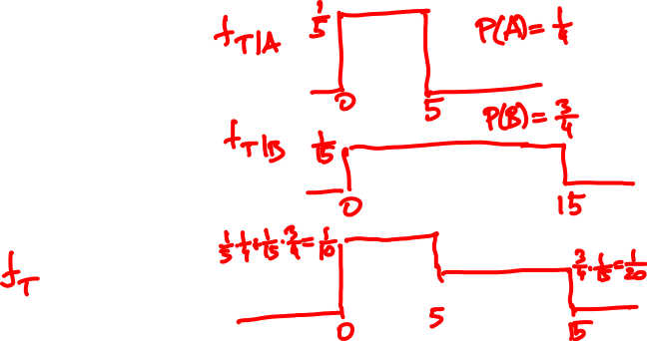
Arrival time is Uniform(10, 30)
2430A
Unconditional waiting time PDF:
8.15 AM
8.30 AM

Slide 26
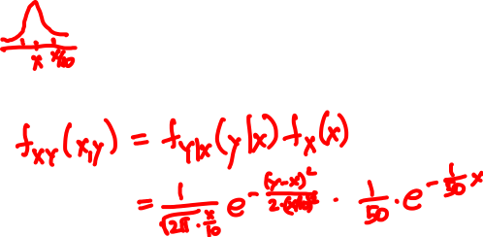

👮‍♂️
50
🚙
Y = Normal(X, X/10)
X = Exponential(1/50)
E[Y] =

Slide 27
Independence
X and Y are independent if
f_{XY}(x, y) = f_{X}(x) f_{Y}(y) for all x, y
if and only if
E[g(X)h(Y)] = E[g(X)]E[h(Y)] for all g, h

Slide 28
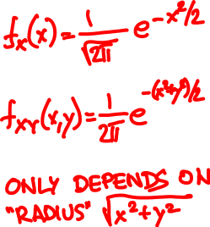
Independent Normals
X, Y are Normal(0, 1)

Slide 29
Independent Normals
X is Normal(μ, σ), Y is Normal(μ’, σ’)

Slide 30
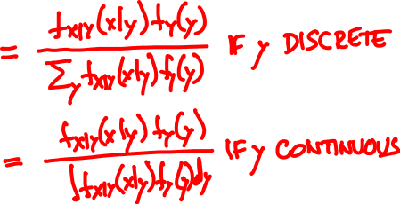
Continous Bayes’ rule
f_{X|Y}(x | y) f_{Y}(y)
f_{Y | X}(y | x) =
f_{X}(x)

Slide 31


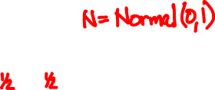
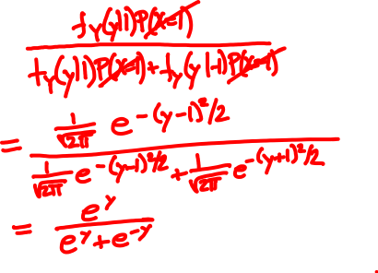
X = 1 or -1
Y = X + N
P(X = 1 | Y = y) =

Slide 32
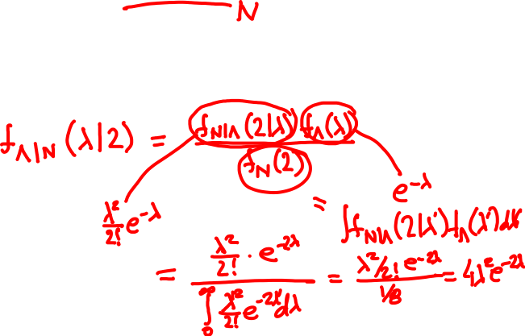
Rain falls at Poisson(Λ) drops/sec
Λ itself is Exponential(1)
You’re hit by 2 drops. What is your guess for Λ?

